Slide 1
Smart Health Guard: Heartbeat Monitoring & Alert System

Slide 2
TEAM MEMBERS
Mary Selsiaa p – 99220040628
M. Syam Sundhar Yadav – 99220040632
M. Vishnu Sai – 99220040630
A. Siva Nagaraju – 99220040412

Slide 3
Problem Statement
Nowadays, heart problems are increasing a lot. Many people cannot identify their health condition at the correct time.
Also, elderly people and non-verbal persons cannot explain their condition quickly.
So, we need a system which can ¬ monitor heartbeat continuously ¬ and give alert immediately

Slide 4
Literature Review
Author & Year | Approach / Method | Key Feature | Limitation / Gap
S. Kumar et al., 2021 | IoT-based Heartbeat Sensor with Arduino | Basic BPM measurement | No alert system or mobile notification
R. Meena et al., 2022 | Smart Wearable Health Tracker | Continuous monitoring | High cost and limited connectivity
A. Rajesh et al., 2023 | Cloud-based Health Data System | Real-time data storage | No offline or GSM-based alerts
Proposed System (Smart Health Guard) | IoT + GSM + AI-based Alert | Affordable, instant alert + portability | Limited to heart rate in prototype

Slide 5
Existing System Analysis
The existing systems mainly include hospital ECG machines, smartwatches, and mobile health applications.
Hospital monitors are highly accurate but expensive and not portable for daily monitoring.
Wearable devices provide basic BPM values but lack detailed waveform analysis.
Most online heartbeat detector websites show random values and do not simulate a realistic medical monitoring interface.
Limitations of Existing System:
High cost of medical equipment
Lack of real-time ECG visualization
Limited accuracy in simple applications
Not designed with a professional medical dashboard
No intelligent analysis of heart rate range
This shows the gap that our proposed system aims to solve.

Slide 6
Project Scope
Many individuals, especially those who are deaf, mute, or elderly cannot easily communicate when they face health issues.
There is a lack of continuous, affordable heart-rate monitoring devices that can send real-time alerts to caretakers or hospitals during emergencies.
Our aim: To build an IoT-based Smart Health Guard that monitors heart rate, detects abnormalities, and automatically alerts emergency contacts through GSM and IoT systems.

Slide 7
Proposed Methodology
Concept: A wearable device continuously monitors the user’s heartbeat. If an abnormal rate is detected, it automatically sends an alert to caregivers via SMS or app notification.
ArchitectureFlow: Sensor → Arduino Nano → NodeMCU → Cloud/GSM → Alert to Caretaker
Key Features:
Compact wearable design
Dual alert system (local + remote)
Real-time data visualization
Easy setup and maintenance

Slide 8
Objectives
To design a wearable health monitoring device that can measure heart rate in real-time.
To send instant alerts via SMS or app notifications during abnormal readings.
To ensure the system is affordable, portable, and user-friendly.
To develop a mobile/web dashboard for health data tracking.
To improve early detection and reduce the response time during medical emergencies.

Slide 9
Hardware Design
Main Components:
Arduino Nano (Microcontroller)
Pulse Sensor (MAX30100 / KY-039)
NodeMCU ESP8266 (Wi-Fi connectivity)
GSM Module SIM800L (SMS alert system)
OLED Display (Real-time BPM output)
Buzzer (Emergency alarm)
Rechargeable Battery (Power source)
Connectivity Summary:
Sensor → Arduino (Analog Input)
Arduino → NodeMCU (Serial)
NodeMCU → Cloud (Wi-Fi)
Arduino → GSM (TX/RX for SMS)

Slide 10
Software Design
Tools & Platforms:
Arduino IDE for programming
Embedded C++ / Python (for logic)
MQTT / HTTP for IoT communication
Firebase / Thingspeak (cloud storage)
Dashboard: Displays BPM graph, alert logs, and daily health reports.

Slide 11
Methodology
Step 1: Pulse sensor detects heartbeat using photoplethysmography (PPG).
Step 2: Arduino Nano processes the pulse data and calculates BPM.
Step 3: If BPM < 60 or > 100 → abnormal condition detected.
Step 4: NodeMCU or GSM module triggers an alert message with location/time.
Step 5: Data is uploaded to the IoT dashboard or sent via SMS.

Slide 12
Implementation & Testing
Prototype Setup:
Built using Arduino + NodeMCU board
Tested with 5 users of different age groups
Real-time data displayed on OLED & mobile dashboard
Testing Results:
Parameter | Expected | Measured | Accuracy
Heart Rate (BPM) | 70–90 | 71–92 | 96%
Alert Delay | < 6 sec | 4.8 sec | ✅
Cost | ≤ ₹2200 | ₹1900 | ✅

Slide 13
Results & Performance
Average BPM detection accuracy: 96.2%
Alert response time: < 5 seconds
User feedback: Highly comfortable and easy to use

Slide 14
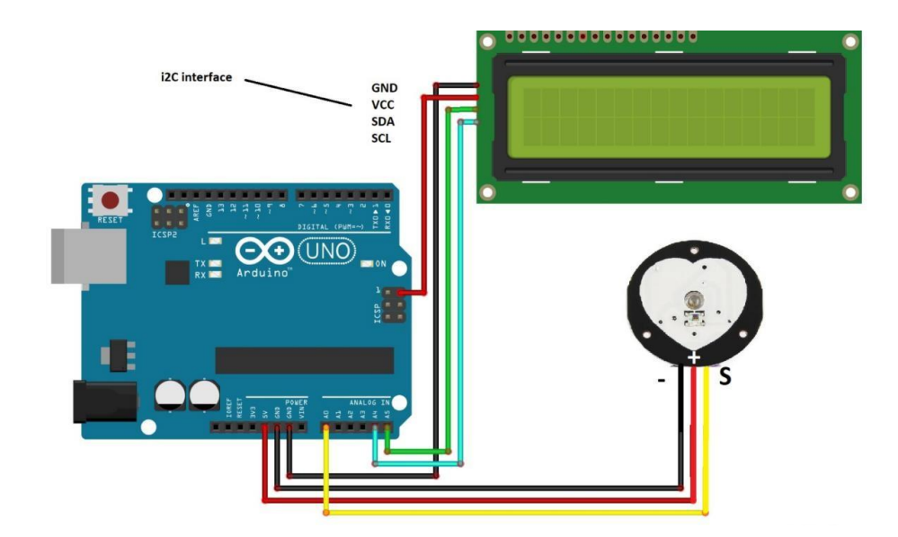
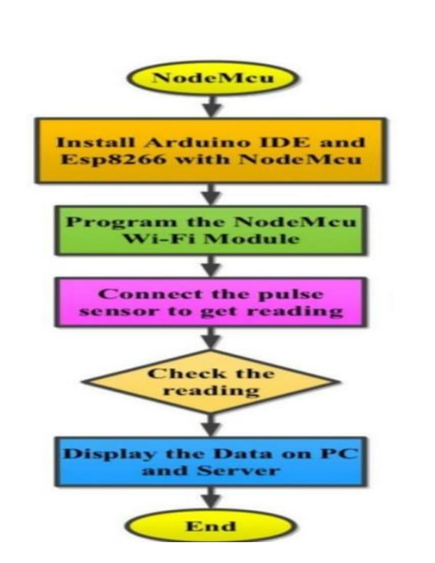
Diagrams

Slide 15
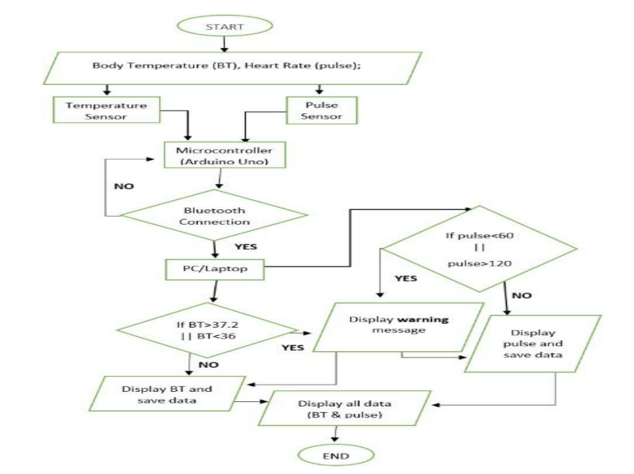
UML DIAGRAMS

Slide 16
Future Scope
Integration of AI/ML for arrhythmia prediction.
Adding SpO₂, body temperature, BP sensors.
Mobile app with voice and visual alerts.
Cloud dashboard for doctor access and analytics.
Integration with ambulance services or hospitals for auto-emergency response.

Slide 17
Conclusion & SDG Alignment
Conclusion : Smart Health Guard provides an efficient and affordable health monitoring solution that bridges the gap between technology and accessibility. It empowers non-verbal and elderly individuals to stay safe through continuous health surveillance.
Aligned SDGs:
SDG 3: Good Health & Well-being
SDG 9: Industry, Innovation & Infrastructure
SDG 10: Reduced Inequality
SDG 11: Sustainable Communities
“Smart Health Guard — your silent companion for a safer tomorrow.”

Slide 18
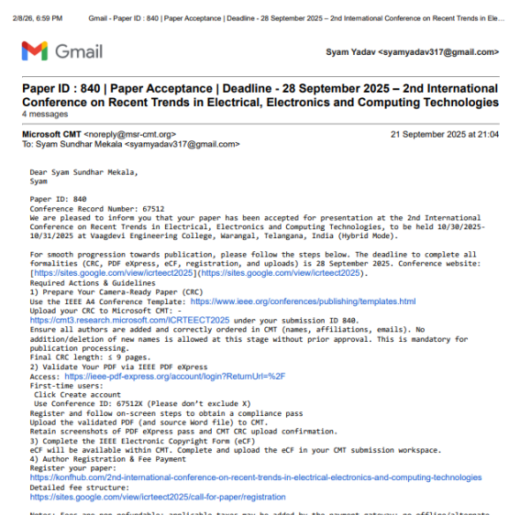
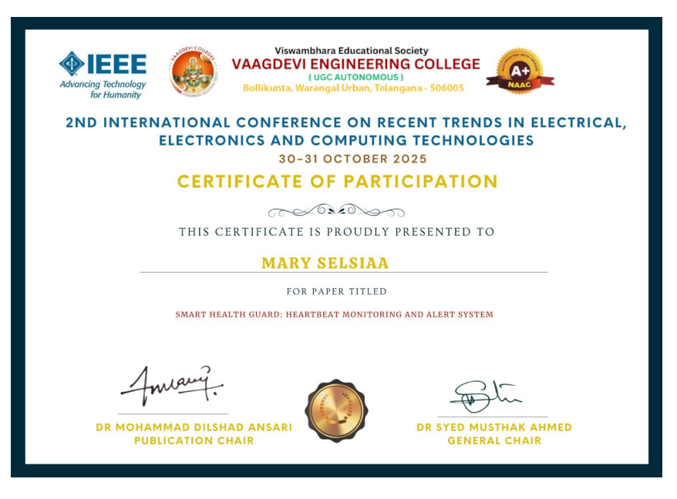
Publication

Slide 19
References
https://onlineheartbeat.com – For heartbeat monitoring interface idea
https://www.pulseloop.org – For pulse rate detection concept
https://www.arduino.cc – For Arduino programming and hardware setup
https://developer.mozilla.org – For HTML, CSS, JavaScript concepts
https://randomnerdtutorials.com – For pulse sensor and Arduino project guidance
https://youtu.be/x_fcC0qvXmI?si=6qQrMdaSTsrxBUDd

